Slide 1

SwissHacks 2024
Financial Innovation with AI
June, 2024

Slide 2
Supercharging teams
Leverage the power of generative AI to get work done in the Financial Services Industries (FSI)
Knowledge Workers for FSI (Labor)
Problem
Solution
Gen AI Value for FSI**
FSI companies have inefficient and ineffective processes*
Growing financial pressure and need to overcome high costs*
Changing expectations from clients and competition
FSI companies fail to drive AI adaption/transformation
Drive productivity in an inspiring way
Replace knowledge worker tasks with AI assistants
Maximize client-facing time for RMs/advisors by unlocking the power of data
Fast implementation
∼ $22 Trillion
∼ $400
Billion
New AI Workforce
* Client case studies conducted with Mobiliar, LGT, Pictet & Goldman Sachs report
** Creating value of $250-410B for banking & insurance according to McKinsey (Link)
Notes:
https://www.investopedia.com/ask/answers/030515/what-percentage-global-economy-comprised-financial-services-sector.asp

Slide 3



















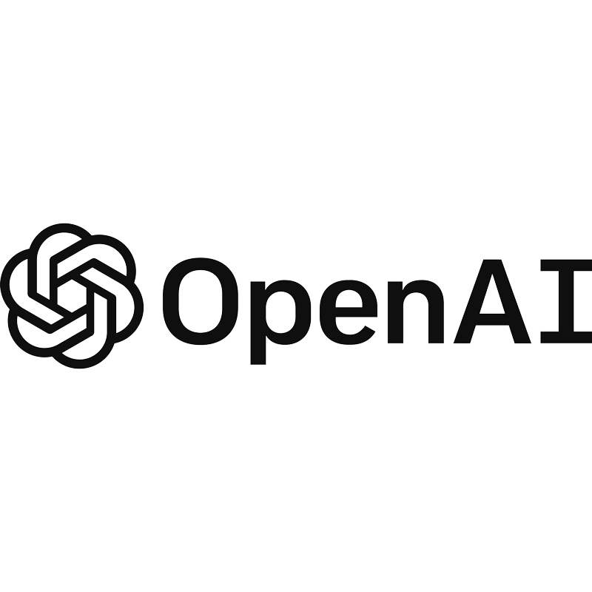

30+ FSI clients
More than 30 FSI leaders trust Unique, making us market leader in CH
We are market leader in Switzerland, having already won 5 of the top 12 private banks in our home market.
We have a strong FSI client base and continue to drive our expansion by acquiring clients outside of central Europe, including clients in Germany, UK, and Singapore.
CHF 21M raised in Seed Rounds, on our way to raise Series A
Wealth management & PE clients
Insurance & retail banks
Partners & collaborations

Slide 4


Problem / Solution
Problem
Solution
Pain Point: Business analysts are drowning in data, struggling to extract meaningful insights from massive annual reports.
Impact: Sector-wide comparison and trend analysis become tedious, time-consuming, and error-prone.
Current Situation: Analysts spend countless hours on manual data extraction and comparison, limiting their ability to focus on strategic tasks.
Innovation: Introducing an AI-powered tool designed to revolutionize data extraction from annual reports.
Efficiency: Automates the extraction and comparison process, drastically reducing the time spent on administrative tasks.
Value: Enhances trend analysis and KPI benchmarking, enabling analysts to focus on high-impact, strategic work.

Slide 5
The Exciting Challenge
Vision: Envision a world where extracting data from extensive reports is as simple as a few clicks.
Scope: While GPT-4o can handle up to 200 pages, our challenge is to manage reports up to 430 pages for multiple companies.
Goal: Create an innovative solution that automates key data extraction, enhancing the speed and accuracy of financial analysis.
Data Format: Data will be provided in markdown format, utilizing state-of-the-art parsing models for enhanced accuracy and consistency.
Technology: Leveraging OpenAI’s flagship model, GPT-4o, alongside cutting-edge open-source libraries to address and solve the challenge effectively.
Impact: Transform the efficiency and accuracy of business analysts.
Opportunity: Engage with real-world problems that have substantial industry impact.
Innovation: Advance the frontiers of AI in financial services, demonstrating both your creativity and technical expertise.

Slide 6

Join the Challenge
Invitation: Bring your creativity, technical skills, and innovation to solve this real-world problem.
Reward: Winning team gets to present their solution to C-level executives at Unique.
Future: Potential to influence the future of financial analysis.

Slide 7
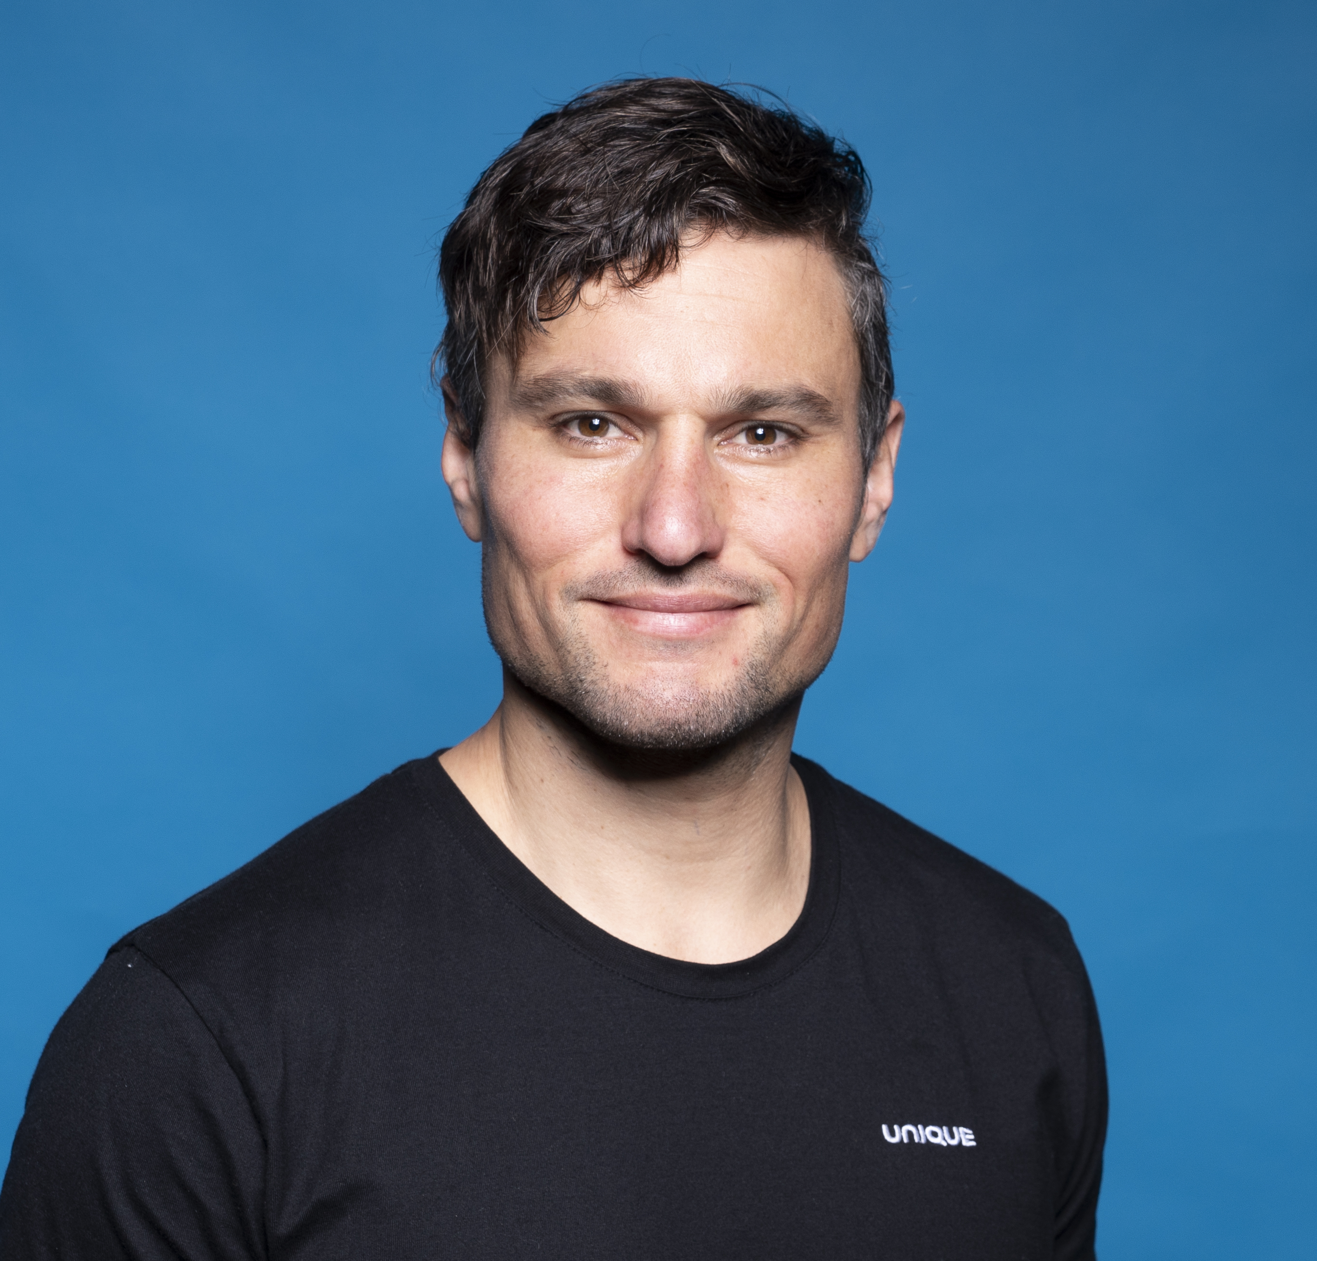
Stay Unique
Pascal Hauri, PhD
Lead Data Scientist
pascal@unique.ch

Slide 8





One single platform
Boost your employees’ productivity with our Unique FinanceGPT platform
Your branded FinanceGPT solution
Microsoft 365
Co-Pilot Plugin
Your embedded data
Documents, Wiki,
and directives
Client conversations
CRM & portfolio data
Plugins & agents
Find Knowledge
Client Summary
Investment
Proposal
Your Own Assistant
Outcomes
Maximize client-facing time
Faster generation of personalized proposals
Automated client summary reports & CRM automation
Uphold compliance standards
Unique Assistants
Connectors
Model Orchestration and Access Control
Enterprise Security (Azure Cloud & Private Environment)
Data Compliance & Governance Layer (DLP*)
LLMs
*DLP: Data Leakage Prevention

Slide 9



Pictet success story
Pictet has 5,000 users live and marks our first client with more than $1M C-ARR
Pictet Case Study*
One.Chat in numbers
5
months from contact to launch
Pictet launched One.Chat in December 2023, a co-developed, GPT-powered platform to make internal information accessible to over 5,000 employees.
5,300
employees
3,000
total users
Employees dedicated considerable time to source relevant information from directives, the intranet, helpdesk resources, HR docs, etc.
1,700
users weekly
23,000
prompts/week
With One.Chat, Unique helps Pictet to retrieve information quickly, translate and summarize documents, generate drafts, support with coding, and segregate information into groups to facilitate access management.
Impact: 1-2 hours saved per week per person
* more information on our website

